Slide 1
World Happiness
Patrick Furlong, Adam Vajdak

Slide 2
Overview
We are combining three datasets from kaggle for an exploratory view of global causes for happiness.
Data: World Happiness Report 2022, Internet Usage and Country Continents
We will be joining these three datasets by Country name which will provide us with one final data frame containing Happiness variables, Internet usage and the continent and region that the country belongs to.

Slide 3
Questions
What countries are the happiest?
What regions are the happiest?
What factors contribute to happiness?
Does Internet usage play a role in a country's happiness score?
Does personal income play a role in happiness score?

Slide 4
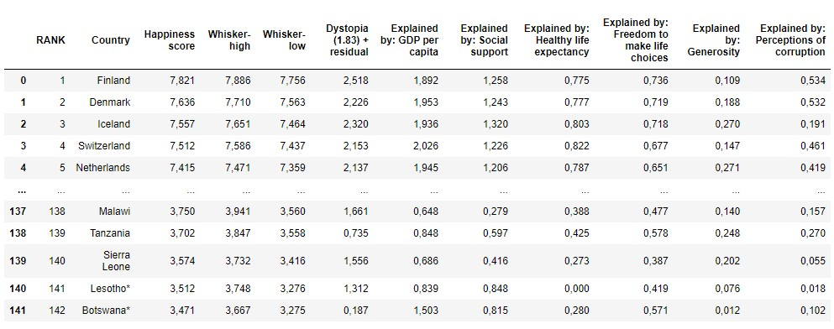
Data- a quick look

Slide 5
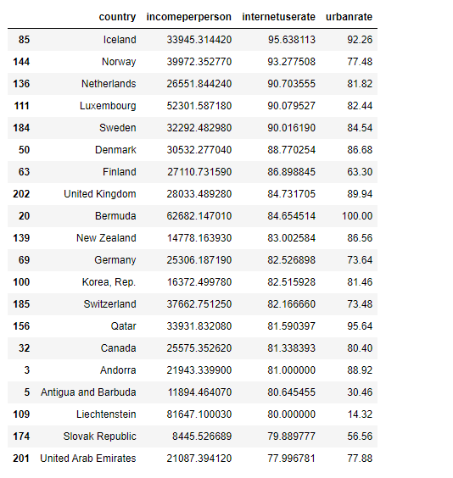
Internet use data
On average out of 100 people have internet access.
USA is ranked 26th with 74.2
Urban pop is a % of people living in urban areas as defined by national offices.
Income is GDP without cost of living taken into account.

Slide 6
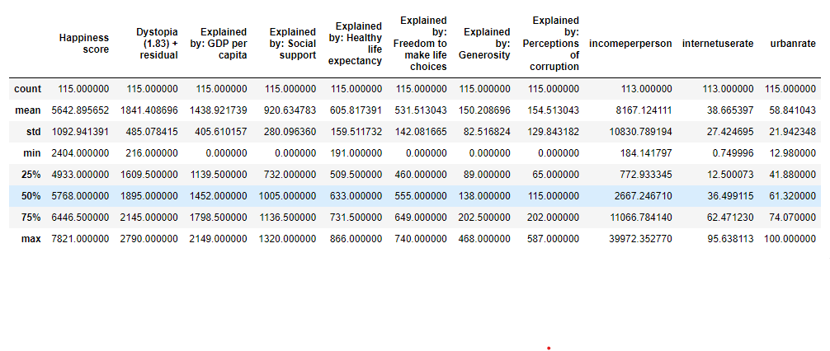
Data- Summary

Slide 7
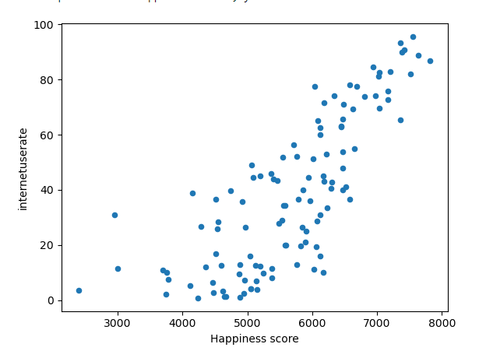
Internet /Happiness

Slide 8
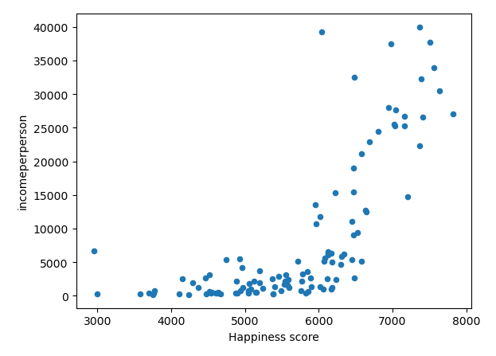
Happiness / income

Slide 9
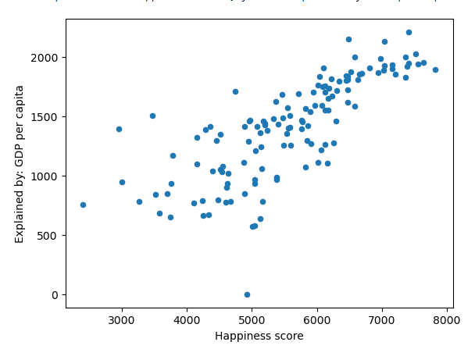
GPD/Happiness

Slide 10
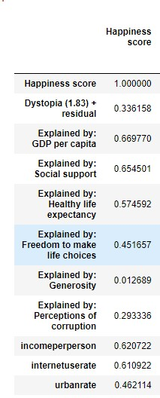
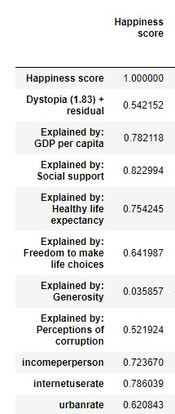
Correlations table
First is a correlation temple using the kendall method.
Next is a correlation temple using the pearson method.

Slide 11
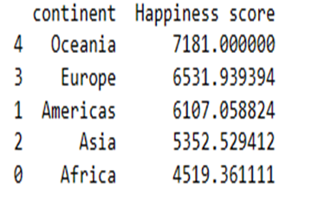
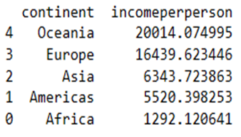
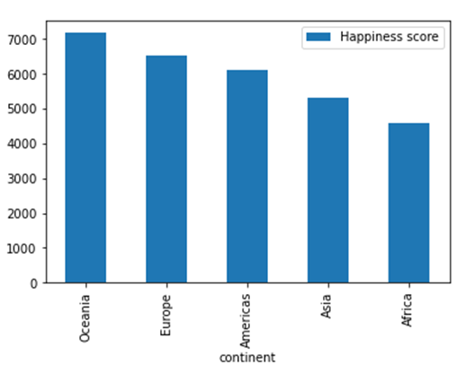
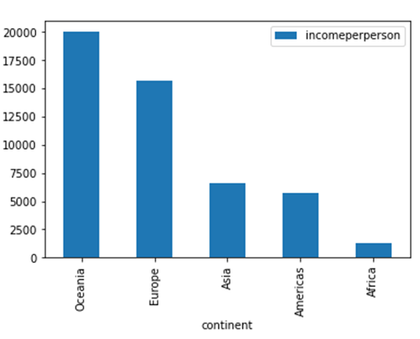
Avg Happiness and Income by Continent
Grouping each country into continents gives a more macro view of Happiness and Income.
Both graphs show a similar trend although income has a steep drop off after Europe and Asia and Americas is reversed.

Slide 12
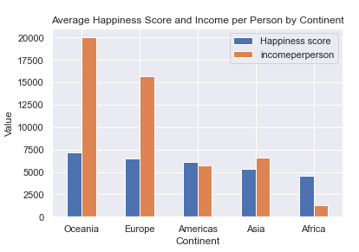
Happiness and Income by Continent (Continued)
Overlapping Happiness and Income shows correlation although Happiness moves slightly with large moves in income.
We know that income is not the only component to Happiness which is reflected here.

Slide 13
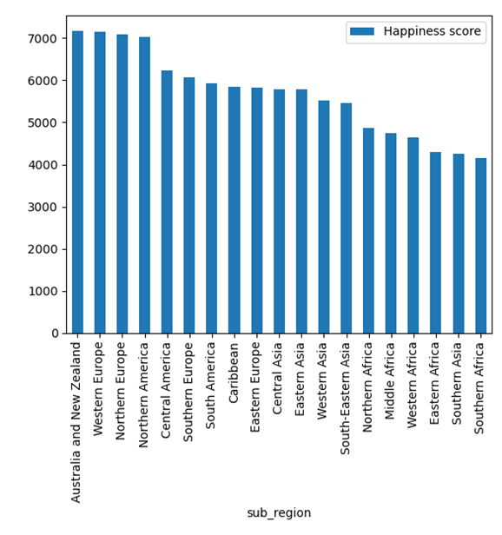
Happiness by Region
Deeper dive into region shows a more specific view of where people are most happy.
Top four include:
Australia and New Zealand
Western Europe
Northern Europe
Northern America

Slide 14
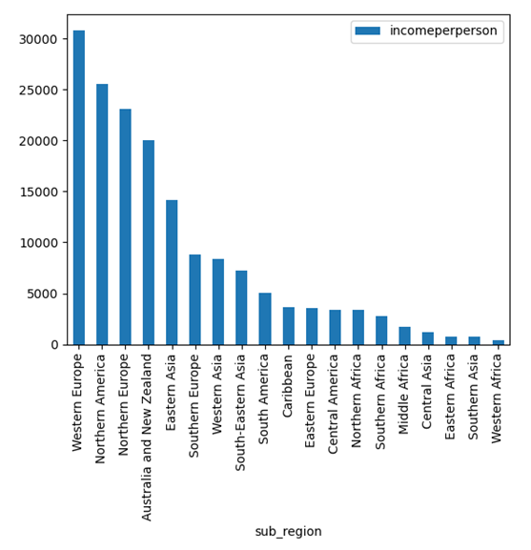
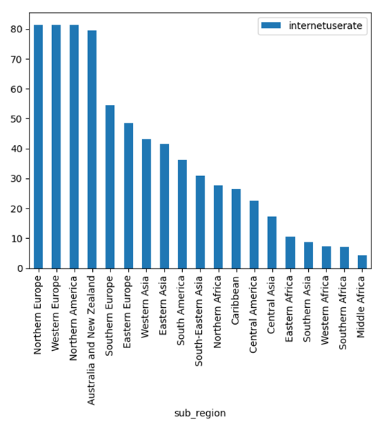
Income and Internet Usage
Same top 4 as Happiness.
Although income decreases among top 4, internet remains competitive.

Slide 15
Summary
Happiness is not just determined by one factor, although some are more important than others.
The happiest countries are Finland,Denmark,Iceland,Switzerland, and the Netherlands.
The factor that supports happiness the most in countries is Social Support.
Which is followed by GDP, income, and internet user rate.
The Internet and income do have a correlation with Happiness although it is not as strong as we thought it does seem to affect it to a degree.

Slide 16
Sources
Global Internet Usage: https://www.kaggle.com/datasets/sansuthi/gapminder-internet
World Happiness Report: https://www.kaggle.com/datasets/mathurinache/world-happiness-report
Countries to continent
https://www.kaggle.com/datasets/statchaitya/country-to-continent

